Slide 1
Tasks
24
7
30
Essential Question
Questions
Notes
Summary
6

Slide 2
24
7
30
Date
Topic: Similarity and Congruence
EQ – How can I determine if a pair of triangles are similar?

Slide 3
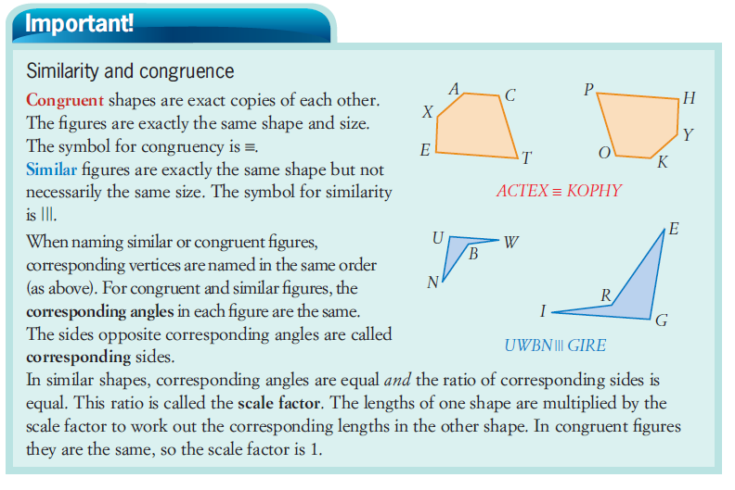
This is the symbol that ~ means “similar.”

Slide 4
Congruency
Two shapes are said to be congruent if they have the same shape and the same size

Slide 5
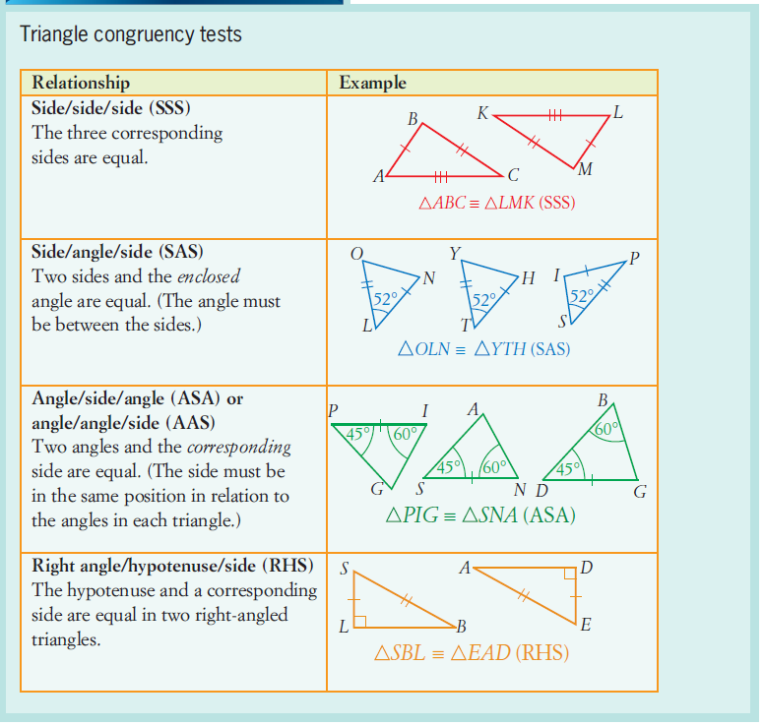

Slide 6
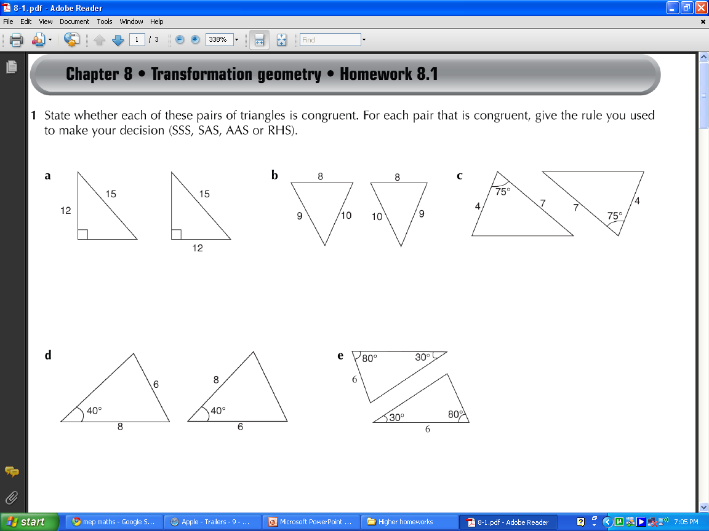
Are these triangles congruent?
☺
SAS

Slide 7
Are these triangles congruent?
☺
SSS

Slide 8
Are these triangles congruent?
☺
RHS

Slide 9
Are these triangles congruent?
☹

Slide 10
Similarity
Two shapes are said to be similar if one is an enlargement of the other (same shape different size).
Triangles are similar if their corresponding angles are the same
Their corresponding sides are then in the same ratio (scale factor).

Slide 11

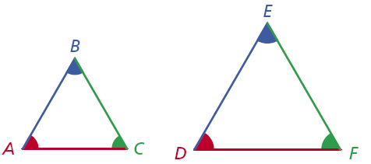
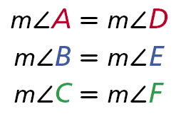
Similar Figures
When stating that two figures are similar, use the symbol ~. For the triangles above, you can write ∆ABC ~ ∆DEF. Make sure corresponding vertices are in the same order. It would be incorrect to write ∆ABC ~ ∆EFD.
You can use proportions to find missing lengths in similar figures.

Slide 12
Scale Factor

Slide 13


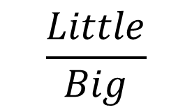
How to find Scale Factor
When a figure is dilated, its size is changed by multiplying the length of each side by a scale factor. All angles remain the same and so the new shape (or image) is similar to the original.
Can be found by dividing a new side length by the original side length.
$$\frac{New }{Old }$$
When going from a small shape to a larger shape the scale factor is greater than 1. (Enlargement)
$$\frac{Big}{Little}$$
When going from a large shape to a smaller shape the scale factor is less than 1. (Reduction)
$$\frac{Little}{Big}$$

Slide 14
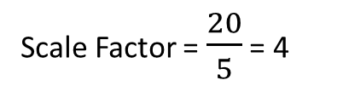
Determining Scale Factor
G
24 cm
x 4
A
6 cm
x 4
8 cm
2 cm
I
C
B
x 4
20 cm
5 cm
H
To find the scale factor can you determine what factor was multiplied by a side length to create the corresponding side length?
Scale Factor = $\frac{20}{5}$ = 4
The scale factor from the small triangle to the larger triangle is 4!
These two triangles are similar because the ratio of corresponding sides is the same.

Slide 15
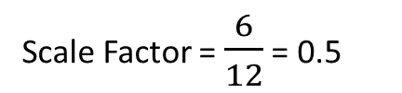
Determining Scale Factor
W
R
x ½
20 cm
10 cm
16 cm
x ½
8 cm
V
6 cm
M
x ½
H
12 cm
B
To find the scale factor can you determine what factor was multiplied by a side length to create the corresponding side length?
Scale Factor = $\frac{6}{12}$ = 0.5
The scale factor from the large triangle to the smaller triangle is 0.5!
These two triangles are similar because the ratio of corresponding sides is the same.

Slide 16
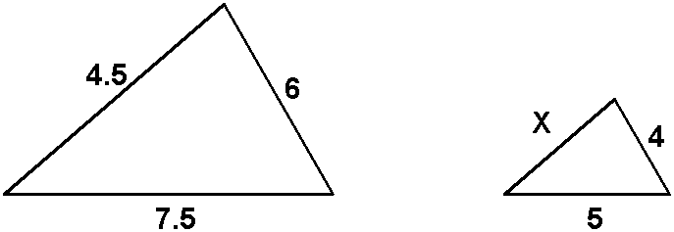
Example: Finding the length of a Side of Similar Triangles
The two triangles below are similar, determine the length of side x.

Slide 17
Example: Continued

Slide 18
Similar Triangles
A
X
80º
9cm
80º
5cm
15cm
27cm
70º
30º
C
B
8cm
70º
30º
Z
24cm
Y
These two triangles are similar because:
Angle ABC = Angle XYZ
Triangle XYZ is an enlargement of triangle ABC
Scale factor 3
Angle ACB = Angle XZY
AND
SO
Angle BAC = Angle YXZ

Slide 19
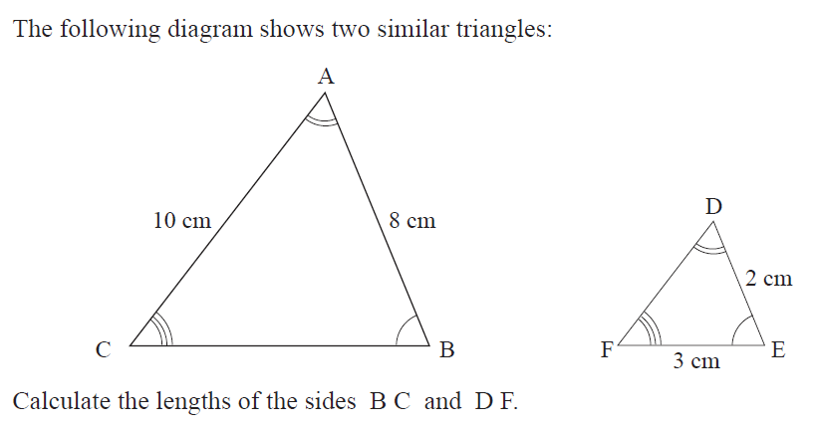
Similar Triangles

Slide 20
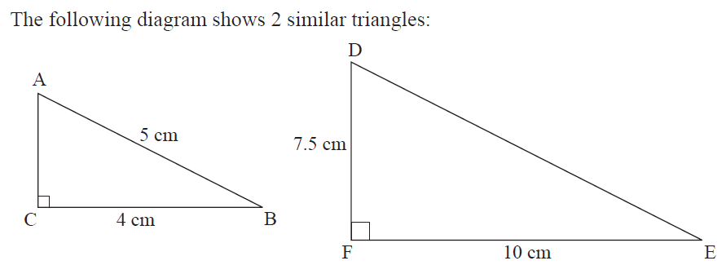
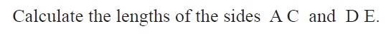
Similar Triangles

Slide 21
AAA Similarity (Angle-Angle-Angle)
If 2 angles of one triangle are congruent to 2 angles of another triangle, then the triangles are similar.
Given:
and
Conclusion:
by AAA

Slide 22
SSS Similarity (Side-Side-Side)
If the lengths of the corresponding sides of 2 triangles are proportional, then the triangles are similar.
Given:
Conclusion:
by SSS

Slide 23
Example: SSS Similarity (Side-Side-Side)
5
8
10
16
11
22
Given:
Conclusion:
By SSS

Slide 24
SAS Similarity (Side-Angle-Side)
If the lengths of 2 sides of a triangle are proportional to the lengths of 2 corresponding sides of another triangle and the included angles are congruent, then the triangles are similar.
Given:
Conclusion:
by SAS

Slide 25
Example: SAS Similarity (Side-Angle-Side)
5
10
11
22
Given:
Conclusion:
By SAS

Slide 26
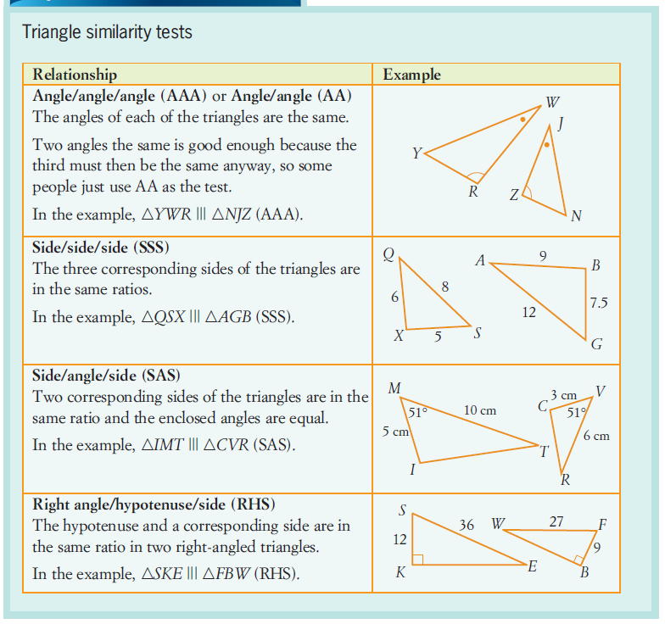

Slide 27
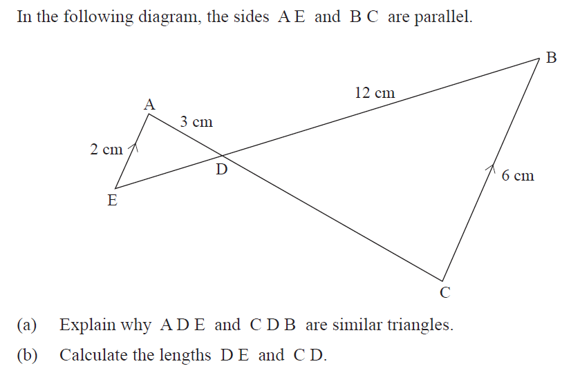
Similar Triangles

Slide 28
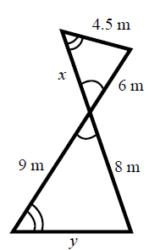
Similar Triangles
The two triangles below are similar. Calculate the value of x and y

Slide 29
Similar Triangles
Show that the triangle APQ is similar to triangle ABC
Hence find the missing length BC
A
6cm
P
Q
5cm
3cm
B
C

